Slide 1
Modern SQL Server Features That Make Life Better
Notes:
Good morning and I'm glad everyone could join us. This morning we're going to be talking about “Modern SQL Server Features That Make Life Better.”

Slide 2
Thank You!
Thank you, GroupBy Conference!!

Slide 3













Thank you to our Sponsors!

Slide 4




About Me
Entered IT in Feb 2008
MCTS SQL Server 2008 Implementation and Maintenance in May 2013
Database Administrator since 2014
Blog at https://leemarkum.com/
Speaking: Meetups, New Stars of Data in 2021, online for Pass in 2022, SQL Saturday Columbus in 2023, and Saint Louis DevUp in 2024
Currently a Senior Database Administrator at Rocket Companies (Views expressed here are my own)
Contact: lmarkum@live.com, https://www.linkedin.com/in/leemarkum/ , @leemarkum on X
Notes:
Here is a bit about me. I got my start in SQL Server 15 years ago by using SQL Server Reporting Services to build custom reports for my employer.
I was also fascinated by the SQL Server engine underneath and at the time I also got the chance to learn SQL Server transactional replication as part of supporting a key application.
I did a lot of self study and 5 years after starting with SQL Server I earned my first certification. I earned two more earlier this Spring. I would encourage you to look at my blog at leemarkum.com and you can contact me on twitter using @leemarkum. You can also find me on LinkedIn, or feel free to email me at the address on the slide.

Slide 5
Setting Expectations
The goal is to introduce you to useful modern features, not provide in-depth coverage. That would take several days.
I am only considering features from the database engine and not SSIS, SSRS, or SSAS.
There are a lot of features I could have chosen from.
Notes:
I am mostly trying to introduce features to you and do so in a way that highlights why it makes your life better as a SQL Server professional. All of these categories could be full length presentations in and of themselves so I simply can’t provide in-depth coverage of the features.
SSIS, SSRS and SSAS have all had enhancements since SQL Server 2012, but I don’t work in those realms very much so I can’t offer information on those enhancements.
If your favorite feature isn’t in the presentation, then just know that I had to make some choices about what to include and what to leave out.

Slide 6
Modern SQL Server Features That Make Life Better
How did I decide which SQL Server versions to discuss?
https://sqlserverupdates.com/
Extended support for SQL Server 2012 ended in July 2022.
Extended Support for SQL Server 2014 ended in July 2024.
Notes:
So, how did I decide which SQL Server versions to discuss? I commonly use the website on the slide to tell me about new patching and it also has dates for end of life for mainstream and extended support.
Extended support for SQL Server 2012 ended in the Summer of 2022. This means no more patching for SQL Server 2012 - even security patches have stopped. So really the minimum version that you should have in your environment is SQL Server 2014, which goes out of extended support in July 2024.
Based on that, I’m covering features that first appeared in SQL 2014 and above in this presentation. The exception to that guideline is Availability Groups, and I’ll also mention ColumnStore indexes, which both first appeared in SQL 2012.
I’m breaking the rule for these features because they continued to evolve in significant ways after SQL Server 2012, and because I am a big fan of AGs and in the right scenario ColumnStore indexes are amazing.

Slide 7
Agenda
Discuss features in the following categories:
Performance
Troubleshooting
T-SQL
High Availability/Disaster Recovery
Notes:
Our agenda is to touch on the following categories of features so that you can see how modern SQL Server features will simplify or improve your experience as a data professional.
We’re going to look at some performance related features in SQL Server followed by new aspects of the product that I think are helpful for troubleshooting.
Next, we’ll look at some useful changes concerning permissions and then we’ll cover some helpful T-SQL changes.
Last, we will consider to features in the category of High Availability and Disaster Recovery.

Slide 8
Agenda
Discuss features in the following categories:
Performance
Troubleshooting
Permissions
High Availability/Disaster Recovery
Notes:
Our agenda is to touch on the following categories of features so that you can see how modern SQL Server features will simplify or improve your experience as a data professional.
We’re going to look at some performance related features in SQL Server followed by new aspects of the product that I think are helpful for troubleshooting.
Next, we’ll look at some useful changes concerning permissions and then we’ll cover some helpful T-SQL changes.
Last, we will consider to features in the category of High Availability and Disaster Recovery.

Slide 9
Modern SQL Server Features That Make Life Better
Performance Features
Notes:
The first category of features that we will discuss is the Performance category.

Slide 10
Performance Features
Lightweight Query Profiling
https://bit.ly/3N2drhB (Query Profiling Infrastructure - SQL Server | MS Learn)
sys.dm_exec_query_profiles (SQL 2014 SP2 but enhanced in later versions)
Use Trace Flag 7412 to enable globally in SQL Server 2016SP1 and SQL Server 2017.
On by default in SQL Server 2019.
Can be used to see index creation progress, which wasn’t really possible prior
Notes:
Now let’s look at Lightweight Query Profiling.
To understand Lightweight Query Profiling, we need to first understand its predecessor, standard profiling infrastructure.
In previous versions of SQL Server, row count information per operator per thread was available, along with CPU runtime data, leveraging features from what is called the Standard Profiling Infrastructure.
The catch is that this involved capturing the queries you wanted to know about ahead of time and then re-running them after turning on SET STATISTICS PROFILE or SET STATISTICS XML. The query_post_execution_showplan extended event could be used to gather the execution plan of an already executed query.
With lightweight query profiling, there is no need to capture queries ahead of time and re-run them. Real time data about a session’s query plan can be collected instead.
A main difference between the standard profile structure and Lightweight Query Profiling is that the new profiling structure does not collect CPU information. The other significant difference is that in 2016 and 17, the feature can be turned on ahead of time with a trace flag so there’s no need to capture a query and then re-run it. In SQL Server 2019, this lightweight query profiling is on by default.
This feature can also be used to get progress on index builds.
Let’s see a demo of this feature that helps us answer the question, should I kill this query? This demo comes from code made available from Bob Ward’s Github (https://github.com/microsoft/bobsql) and goes along with his book “SQL Server 2019 Revealed”
Download and restore a copy of the WideWorldImporters database.
Enlarge a couple of the tables in that database using the script extendwwi.sql
Open and run a query called “mysmartsqlquery.sql”.
In a separate window run step 1 from “show_active_queries.sql” from Bob’s SQL2019Book folder.
Keep executing this “show_active_queries” SQL and notice the CPU increasing and async_network_io waits. The query is using a lot of CPU and the client, in this case SSMS, is getting back a lot of results and there are waits associated with the client showing those results.
Run Step 2 from the “show_active_queries” SQL. This is where you get the query profile information from the new feature. Notice the huge row estimates and the slowing rising row count columns where ethe Nested Loops and Table Sppol operators are. Keep executing this and you can see that this query is going to take forever to finish.
Now run step 3 and look at the execution plan. Hover over the Nested Loops operator and notice that it says at the bottom of the tooltip “Warnings: no join predicate”
Look back at the query and notice the typo where the query joins the SI table to itself and not to SIL.

Slide 11
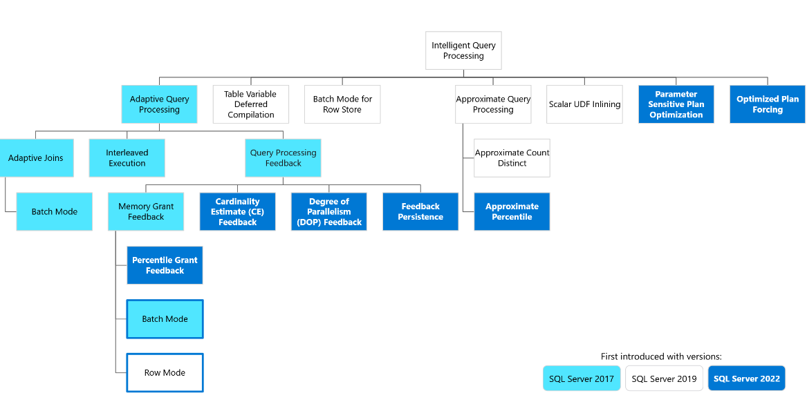
Performance Features
Intelligent Query Processing Picture from MS Learn https://bit.ly/3C0Zn1B
Notes:
Intelligent Query Processing is a collection of new database engine features, some of which began appearing in SQL Server 2014 and 2016. Some of these features, like memory grant feedback, were enhanced in later versions SQL Server, while more features appeared in each new version of SQL Server. This topic alone could be an entire day’s pre-conference session so I’m only going to touch on a few of these.

Slide 12
Performance Features
Intelligent Query Processing
Includes, but not limited to, features such as:
Adaptive Joins (SQL Server 2017)
Interleaved Execution for MSTVFs(SQL Server 2017)
Memory Grant Feedback – Batch mode (SQL Server 2017)

Slide 13
Performance Features
Intelligent Query Processing
Includes, but not limited to, features such as:
Memory Grant Feedback - Row Mode (SQL Server 2019)
Memory Grant Feedback – Percentile and Persisted (SQL Server 2022)
DOP_Feedback (SQL Server 2022)
Forced plan optimization – compilation script creation (SQL Server 2022)

Slide 14
Performance Features
Memory grant feedback (SQL Server 2017)
Does not require Query Store as it affects cached plans
Can reduce spills to disk by increasing memory grants
Can reduce wasted memory by lowering memory grants that are too high
- Can result in a “zig-zag” effect where memory grants are constantly shifting up and down. In this scenario, memory grant feedback disables itself.
Notes:
Memory Grant Feedback is meant to help with scenarios when too much or too little memory is requested for a query. When a query needs to run, a request for memory is made so that the query can run. This is called a memory grant. Once received, then a query can continue being processed by the engine.
For an excessive memory grant condition, if the granted memory is more than two times the size of the actual used memory, memory grant feedback will recalculate the memory grant and update the cached plan.
A memory grant that is too small can occur when SQL Server underestimates the number of rows involved in an operation. When this happens then a spill to disk over on Tempdb occurs. This means that the data that couldn’t be handled in memory was processed on disk in TempDB. When a disk spill occurs in these newer versions of SQL Server, the engine now adjusts to provide the query more memory the next time it runs, thus avoiding the spill to Tempdb and making performance better next time.
Spill events are reported to memory grant feedback and can be surfaced via the spilling_report_to_memory_grant_feedback extended event.

Slide 15
Performance Features
Memory grant feedback (SQL Server 2017)
Feedback is lost on SQL Server restart or use of RECOMPILE
Needs database compatibility level 140 for batch mode and 150 for row mode
Memory grant feedback activity is visible via the XEvent called memory_grant_updated_by_feedback

Slide 16
Performance Features
Persisted and Percentile memory grant feedback (SQL Server 2022)
- Needs compat level 140 and higher.
- Needs Query Store enabled and in read-write mode.
Notes:
In SQL Server 2022, at compat level 160 and with Query Store enabled, memory grant feedback is persisted in the Query Store. No longer is memory grant feedback information lost when SQL Server restarts or the machine is rebooted.
Additionally, rather than queries experiencing the potential for excessive and then too little memory grant, like in SQL Server 2017, a percentile calculation is used over the course of several executions of the same query. This prevents large swings in memory grants for the same query that uses different parameter values.
“This feature was introduced in SQL Server 2022 (16.x), however this performance enhancement is available for queries that operate in the database compatibility level 140 (introduced in SQL Server 2017) or higher, or the QUERY_OPTIMIZER_COMPATIBILITY_LEVEL_n hint of 140 and higher, and when Query Store is enabled for the database and is in a "read write" state.”

Slide 17
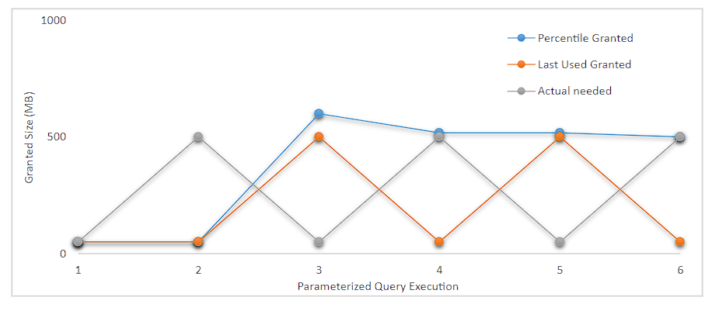
Performance Features
Persisted and Percentile memory grant feedback (SQL Server 2022)
https://bit.ly/485EOQZ MS Learn Memory Grant Feedback
Notes:
In SQL Server 2022, at compat level 160 and with Query Store enabled, memory grant feedback is persisted in the Query Store. No longer is memory grant feedback information lost when SQL Server restarts or the machine is rebooted.
Additionally, rather than queries experiencing the potential for excessive and then too little memory grant, like in SQL Server 2017, a percentile calculation is used over the course of several executions of the same query. This prevents large swings in memory grants for the same query that uses different parameter values.
“This feature was introduced in SQL Server 2022 (16.x), however this performance enhancement is available for queries that operate in the database compatibility level 140 (introduced in SQL Server 2017) or higher, or the QUERY_OPTIMIZER_COMPATIBILITY_LEVEL_n hint of 140 and higher, and when Query Store is enabled for the database and is in a "read write" state.”

Slide 18
Performance Features
DOP_Feedback (SQL Server 2022)
Needs compat level 160
Needs Query Store enabled and in read/write mode
Only verified feedback is persisted
- Feedback will be persisted in the sys.query_store_plan_feedback catalog view when we reach a stable degree of parallelism feedback value.
Notes:
DOP feedback self-adjusts DOP to avoid excess parallelism. If parallelism usage is deemed inefficient, DOP feedback lowers the DOP for the next execution of the query, from whatever is the configured DOP, and verify if it helps.

Slide 19
Performance Features
CE_Feedback (SQL Server 2022)
CE feedback identifies model-related assumptions and evaluates whether they're accurate for repeating queries.
Are the data points in two columns, like City and State, related? Old CE - No/ New CE - Yes
CE Feedback reviews actual versus estimated rows to determine if an assumption may be incorrect. If the assumption seems incorrect, then later executions of the same query are tested with different CE assumptions.
If the alternate CE assumptions improve plan quality, the old query plan is replaced with a query plan that uses the appropriate USE HINT query hint that adjusts the estimation model, implemented through the Query Store hint mechanism.
Notes:
Current slide notes are copied from a MS Learn page. Please summarize and rephrase.

Slide 20
Performance Features
Forced plan optimization – optimization replay script creation (SQL Server 2022)
- Essentially, SQL Server can decide that creating and storing a script to do the plan optimization is more efficient than going through the optimization process from scratch for a given query.
- What is considered in this process?
Number of objects accessed
The number of joins
The number of optimization tasks executed during optimization
The actual optimization time

Slide 21
Performance Features
Forced plan optimization – optimization replay script creation (SQL Server 2022)
- Needs compat level 160
- Needs Query Store enabled and in read/write mode
- ALTER DATABASE SCOPED CONFIGURATION SET OPTIMIZED_PLAN_FORCING = ON;
- sys.query_store_plan DMV has a bit column for has_recompile_script
- https://bit.ly/3O2IYAE

Slide 22
Performance Features
Forced plan optimization – compilation script creation (SQL Server 2022)
Select all queries that have an optimization replay script
SELECT q.query_id, t.query_sql_text, p.plan_id, TRY_CAST(p.query_plan as XML) as query_plan,
p.is_forced_plan, p.count_compiles
FROM sys.query_store_plan AS p
INNER JOIN sys.query_store_query AS q on p.query_id = q.query_id
INNER JOIN sys.query_store_query_text AS t ON q.query_text_id = t.query_text_id
WHERE p.has_compile_replay_script = 1;

Slide 23
Performance Features
Query Store(2016)
https://bit.ly/2JGUC5J (Lee Markum - Overview of Query Store)
https://bit.ly/4cUUgjO (Erin Stellato - Why you Need Query Store)
https://bit.ly/3W61tqw (Erin Stellato - Query Store Best Practices)
Stores query runtime performance from the perspective of CPU, Duration, logical reads and other metrics
Wait Stats information is available in SQL 2017 and above
Custom Capture Policies in 2019 to allow better control over what is captured so Query Store performs better and collects more filtered data.
Notes:
Query Store solves the challenge of persisting performance data over time. Prior to Query Store, there was the Management Data Warehouse in SQL Server, and that feature can still be enabled, but Query Store is superior to Management Data Warehouse.
Query Store is easier to turn on and has very little management needed, unlike what I experienced when testing the Management Data Warehouse feature. Outside of that, you had to have a server-side trace collecting data, or later, extended events sessions capturing performance.
Both of these methods, but particularly server-side trace, has some significant overhead depending on what you’re trying to capture – like query plans, for example. You could also do things like record the output of Adam Machanic’s sp_whoisactive to a database.
I don’t think any of these approaches gives you the kind of insight that Query Store provides and all of these previously mentioned options are things that you would have to manage on a regular basis, or put a fair amount of effort into just to set up and capture what you’re interested in.
So, Query Store makes life better simply by freeing you from having to create and manage your own monitoring process or convince your boss to buy pricey monitoring software from a 3rd party. And some employers only want to use native monitoring methods and say so in their job postings.

Slide 24
Performance Features
Query Store(2016)
Is enabled at the database level
Stores query plans and related performance metrics
Allows you to detect regression and force “good query plans”
Various reports show performance graphically
Notes:
Some additional characteristics of Query Store is that it is enabled per database. You can use it to view not only performance metrics for queries, but query plans as well.
Let’s look at some information collected in the WideWorldImporters database when we did the demo on LightWeight Query Profiling.

Slide 25
Performance Features
Query Store(2016)
Use TF 7745 to prevent Query store data from writing to disk before shutdown (This TF is not available in AWS RDS)
Use TF 7752 to enable Query Store to load data into memory asynchronously and not prevent query execution while it loads. This is the default in 2019.
Fantastic to use as a before/after for migrations
Query Store in SQL Server 2022
Notes:
There are a couple of important trace flags for Query Store.
Besides the query regression report that is built-in, you can also get the top X reports by memory, reads, duration, etc for the 2 weeks prior to a migration and the same query ID values for the two weeks after. With some math, you can determine whether the metric you are measuring got better or worse after the migration.
In SQL Server 2022, the Query store plays a central role in most of the newer intelligent query processing features. More stable memory grant feedback, DOP_Feedback, CE Feedback and more all rely on Query Store.

Slide 26
Performance Features
Tempdb improvements through SQL Server 2022
Tempdb metadata optimization
Notes:
Some additional characteristics of Query Store is that it is enabled per database. You can use it to view not only performance metrics for queries, but query plans as well.
Let’s look at some information collected in the WideWorldImporters database when we did the demo on LightWeight Query Profiling.

Slide 27
Modern SQL Server Features That Make Life Better
Troubleshooting Features
Notes:
The next category of features that we will discuss are features that make troubleshooting data issues easier for the SQL Serve professional.

Slide 28
Troubleshooting Features
Verbose Truncation Warnings(2019)
Msg 8152, Level 16, State 30, Line 13
String or binary data would be truncated.
The statement has been terminated.
CREATE TABLE DemoSQL2019
(
[ID] INT identity(1,1),
[NAME] VARCHAR(10),
)
INSERT INTO DemoSQL2019 VALUES ('SQLSaturday Columbus, OH')
INSERT INTO DemoSQL2019 VALUES ('Brent Ozar Author')
Notes:
Luckily, we have a better error message now! This error message makes life better by reducing your troubleshooting time. The new message tells you exactly what table and column has the problem as well as the value that was truncated!

Slide 29
Troubleshooting Features
Verbose Truncation Warnings(2019)
Msg 2628, Level 16, State 1, Line 13
String or binary data would be truncated in table 'TruncateMessageDemo.dbo.DemoSQL2019', column 'NAME'.
Truncated value: 'SQLSaturda'.
Can be turned on in SQL Server 2017 using trace flag 460.
Available in compatibility level 150 (SQL Server 2019) by default
Notes:
Luckily, we have a better error message now! This error message makes life better by reducing your troubleshooting time. The new message tells you exactly what table and column has the problem as well as the value that was truncated!
Can be turned on in SQL Server 2017 using trace flag 460.
Available in compatibility level 150 (SQL Server 2019) by default

Slide 30
Troubleshooting Features
Temporal Tables/System-Versioned Tables (2016)
Composed of a “normal” table and a history table
Special time range start and time range end columns are added to the normal and history table.
A temporal table must have a Primary Key
Notes:
The next troubleshooting related feature we’ll look at is Temporal tables.
When this feature is enabled on a table, then a history table is created and that table keeps a complete record of updates and deletes to data by tracking the versions of rows based on a time period. The time range start and time range end values represent the time range when the values in the history table were in the source or “temporal” table.

Slide 31
Troubleshooting Features
Temporal Tables/System-Versioned Tables (2016)
Can be a replacement for triggers as a means of tracking changes to tables.
Temporal Tables do not track WHO made the modification. But see Aaron Bertrand’s solution for that here on MSSQLTips: https://bit.ly/3672sNH
For tracking WHO as well as WHAT, see the new Ledger feature (SQL 2022)
Can help you answer, what happened to the data and when, making the feature useful for auditing

Slide 32
Troubleshooting Features
Temporal Tables/System-Versioned Tables (2016)
Run queries to show trends over time
Oops deletes and temporal tables.
No need for side by side restore of a database to examine and recover data, saving hours of delays to start fixing data on a VLDB.
Use the StartTime and EndTime values for rows to find the records you need to restore from the history table.
https://bit.ly/4fFQyNa - MSSQLTips.com example
https://bit.ly/3WDgyAf - Bert Wagner example
Notes:
As an example of why you would use this, temporal tables can be used to track pricing changes for products over time, analyze those changes for trends, and recover versions of rows that existed before accidental changes were made. This last point is a fantastic one because it allows for recovery of rows without the need for a restore operation. This feature is also useful for auditing of changes in a table.
This feature is fantastic for quickly being able to find data that needs to be put back into the original table due to an oops change.
(Tell the story of an employee who was allowed to connect MS Access directly to a table and make changes in the SQL table and how this offered some protection for the data.)
Now, let’s see a demo of Temporal Tables.

Slide 33
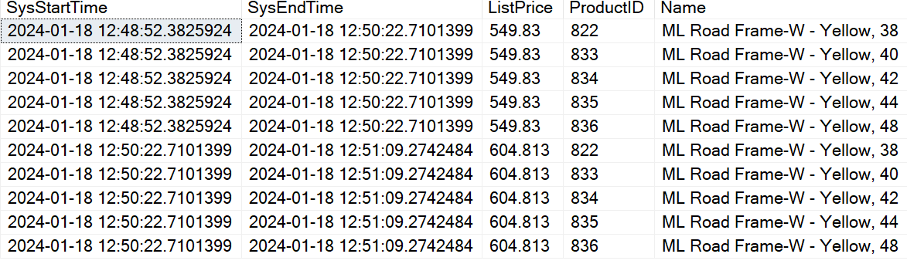

Troubleshooting Features
Temporal Tables/System-Versioned Tables (2016)
An example: Increased the product price by 10% two times.
Notes:
Here we have an example of a history table.
Let’s say a Developer was asked to raise the price of certain products by 10%. Those first few rows where the price is $539.83 was the original price, before the 10% increase. Those were were active between the SysStartTime and SysEndtime.
Now let’s say that the same script was ran a second time some time later on. The next set of rows that have the price of $604 show that the price has been changed again and those rows have no been archived.
(Tell the story of an employee who was allowed to connect MS Access directly to a table and make changes in the SQL table and how this offered some protection for the data.)

Slide 34
Permission Enhancement Features
Permission Enhancements Features
Notes:
The next category of features that we will discuss is related to permission enhancements.

Slide 35
Permission Enhancement Features
Permission Enhancements(SQL 2014)
Granting Users Read/SELECT permissions is now easier
CONNECT ANY DATABASE – Grants a login access to all current and future databases. Can be combined with other permissions to provide further capabilities
SELECT ALL USER SECURABLES – Grants SELECT permissions to all objects to which a login has access.
Notes:
CONNECT ANY DATABASE – Grants the connect permission to a login. Can be combined with other permissions to provide further capabilities. For example, if you combine this permission with GRANT VIEW SERVER STATE, then a login can monitor performance via DMVs without being granted access to the data in the databases.
SELECT ALL USER SECURABLES – Grants SELECT permissions to all objects to which a login has access. When combined with CONNECT ANY DATABASE this is a simple way to grant read permissions to all databases at the server level. This can be useful for SQL Report Writers or business users who are power users and may make their own reports without requests to an IT Department.

Slide 36
Permission Enhancement Features
Permission Enhancements(SQL 2022)
10 new server level roles in SQL Server 2022
https://bit.ly/3D9xm8P - MS Learn Link to all 10
https://bit.ly/3JRlsnJ - mssqltips (Compare SQL Server ##MS_LoginManager## and Securityadmin Role)
##MS_LoginManager## - can create, delete and modify logins w/o all the additional permissions that securityadmin allows.
Notes:
Many of these new roles are designed to give people access to server and database scoped DMVs that require the VIEW Server State or VIEW Database permission
Recently used the new loginmanager role to allow a PowerShell job to copy logins to maintain a traditional Availability Group.

Slide 37
Modern SQL Server Features That Make Life Better
T-SQL Enhancements Features
Notes:
The next category of features that we will discuss T-SQL enhancements.

Slide 38
T-SQL Features
FileTable(SQL Server 2012) – Could use this to hold and search pictures from a table (photography hobby or business inventory on a sales page) https://bit.ly/3YAOGPO Simple-talk Louis Davidson
OFFSET FETCH for pagination(2012) Shows ‘x’ number of rows on a page https://bit.ly/3YK1nGH Aaron Bertrand sqlperformance
THROW for raising errors (2012) – condenses the syntax needed to raise an error and replaces RAISERROR in many cases
Notes:
https://www.red-gate.com/simple-talk/blogs/filetables-great-for-business-great-for-hobbyist/
https://voiceofthedba.com/tag/filetable/
https://www.c-sharpcorner.com/UploadFile/rohatash/top-10-exciting-new-features-of-sql-server-2012/
https://sqlperformance.com/2015/01/t-sql-queries/pagination-with-offset-fetch

Slide 39
T-SQL Features
DATEFROMPARTS (SQL Server 2012)
TIMEFROMPARTS (SQL Server 2012)
DATETIMEFROMPARTS (SQL Server 2012)
EOMONTH (SQL Server 2012) – Prevents the need for writing a UDF
Notes:
The FROMPARTS functions let you build either a date, time or full datetime value from parts or values that you pass to the functions.
EOMONTH lets you pass values in and returns the last day of the month for the value passed in. No more building custom UDFs.

Slide 40
T-SQL Features
Inline specification of CLUSTERED and NONCLUSTERED indexes (2014)
DROP IF EXISTS(SQL Server 2016SP1)
CREATE OR ALTER(2016SP1) - Can be important for Query Store
Notes:
DROP IF EXISTS greatly simplifies scenarios where you need to see if an object exists and drop it before you create the object. This is useful in situations where you are deploying new SQL objects via SQL scripts. The syntax works for tables, table constraints, table columns, procedures, and triggers
A variation of this is the CREATE OR ALTER syntax. Using this syntax, if the object exists, then it will be altered to match the new definition contained in the script. If the object does not exist already, then it will be created. This new syntax works for views, procedures, functions and triggers. Note this does not work for tables.

Slide 41
T-SQL Features
JSON format support(2016) but enhancements in 17, 22 and Azure SQL DB.
https://bit.ly/46MF6vm Hasan Savran - New Features in SQL Server for Developers
ALTER TABLE WITH ONLINE = ON (2016)
New string functions (2017) CONCAT_WS, TRANSLATE, and TRIM, and WITHIN GROUP is now supported for the STRING_AGG function
Notes:
ALTER TABLE ONLINE allows you to alter many columns while the table remains online, using WITH (ONLINE = ON | OFF). The feature has a fair amount of restrictions, but it does seem like there is some general usefulness to this syntax change. MS Docs indicates that you can use this new syntax for column changes related to data type, column length or precision, sparseness and collation, all while the table remains online.
Index creation can now be done inline when creating the table rather than creating an index after making the table. This works for disk-based tables. I think this just makes the SQL syntax shorter and easier to do than creating the indexes after the table creation. So, for those columns you know need to be indexed from the beginning, this is a faster, simpler way to do it.
A number of string functions were introduced in SQL Server 2017. The one I’m going to demonstrate is the TRIM function. It removes leading and trailing characters and spaces without nesting LTRIM/RTRIM to do it.
Let’s look at a demo of a few of these new T-SQL features.

Slide 42
T-SQL Features
Inline Index Creation:
USE DBAUtility;
GO
DROP TABLE IF Exists t1;
--filtered index
CREATE TABLE t1
(
c1 INT,
index IX1 (c1) WHERE c1 > 0
);

Slide 43
T-SQL Features
Inline Index Creation:
DROP TABLE IF Exists t2;
--multi-column index
CREATE TABLE t2
(
c1 INT,
c2 INT,
INDEX ix_1 NONCLUSTERED (c1,c2)
);

Slide 44
T-SQL Features
Inline Index Creation:
DROP TABLE IF Exists t3;
--multi-column unique index
CREATE TABLE t3
(
c1 INT,
c2 INT,
INDEX ix_1 UNIQUE NONCLUSTERED (c1,c2)
);

Slide 45
T-SQL Features
Inline Index Creation:
DROP TABLE IF Exists t4;
-- make unique clustered index
CREATE TABLE t4
(
c1 INT,
c2 INT,
INDEX ix_1 UNIQUE CLUSTERED (c1,c2)
);
Notes:
ALTER TABLE ONLINE allows you to alter many columns while the table remains online, using WITH (ONLINE = ON | OFF). The feature has a fair amount of restrictions, but it does seem like there is some general usefulness to this syntax change. MS Docs indicates that you can use this new syntax for column changes related to data type, column length or precision, sparseness and collation, all while the table remains online.
Index creation can now be done inline when creating the table rather than creating an index after making the table. This works for disk-based tables. I think this just makes the SQL syntax shorter and easier to do than creating the indexes after the table creation. So, for those columns you know need to be indexed from the beginning, this is a faster, simpler way to do it.
A number of string functions were introduced in SQL Server 2017. The one I’m going to demonstrate is the TRIM function. It removes leading and trailing characters and spaces without nesting LTRIM/RTRIM to do it.
Let’s look at a demo of a few of these new T-SQL features.

Slide 46
T-SQL Features
Traditional Concatenation, CONCAT and CONCAT_WS
USE WideWorldImporters;
GO
SELECT (DeliveryAddressLine2+' '+ C.CityName+' '+DeliveryPostalCode) AS OlderConcatMethod,
CONCAT (DeliveryAddressLine2,' ',C.CityName,' ',DeliveryPostalCode) AS NewConcatMethod,
CONCAT_WS (' ',DeliveryAddressLine2,C.CityName,DeliveryPostalCode) AS CONCAT_WSMethod
FROM [WideWorldImporters].[Sales].[Customers] AS CUST
INNER JOIN [Application].[Cities] AS C ON CUST.DeliveryCityID = C.CityID;

Slide 47
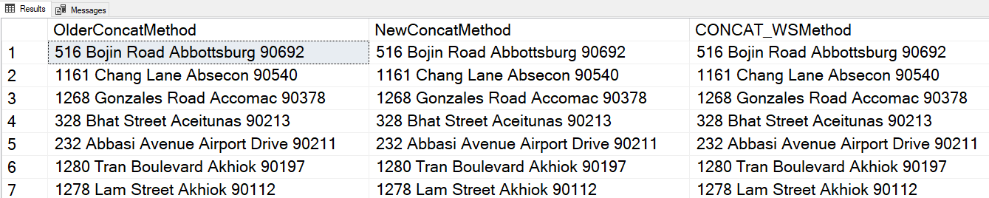
T-SQL Features
Traditional Concatenation, CONCAT and CONCAT_WS

Slide 48
T-SQL Features
SQL Server 2022 Enhancements:
Greatest/Least (eliminates the need for a complex searched CASE or a CROSS APPLY)
GENERATE_SERIES
Window or STRING_SPLIT with the enable_ordinal enhancement enabled
Create index and resumable constraint enhancements
Notes:
Index creation can now be done inline when creating the table rather than creating an index after making the table. This works for disk-based tables. I think this just makes the SQL syntax shorter and easier to do than creating the indexes after the table creation. So, for those columns you know need to be indexed from the beginning, this is a faster, simpler way to do it.
A number of string functions were introduced in SQL Server 2017. The one I’m going to demonstrate is the TRIM function. It removes leading and trailing characters and spaces without nesting LTRIM/RTRIM to do it.
https://www.mssqltips.com/sqlservertip/7265/sql-server-2022-t-sql-enhancements/
https://learn.microsoft.com/en-us/training/modules/introduction-sql-server-2022-t-sql-enhancements/2-resumable-constraints-and-wait-low-priority-index
Let’s look at a demo of a few of these new T-SQL features.

Slide 49
T-SQL Features
GREATEST/LEAST:
A platform you support allows customers to manage email subscriptions to a newsletter. The customer wants to know in which month was the largest and smallest number of opened newsletters from the emails .
https://bit.ly/3M38Dao Examples taken from a SQL Server 2022 article by Aaron Betrand
Notes:
ALTER TABLE ONLINE allows you to alter many columns while the table remains online, using WITH (ONLINE = ON | OFF). The feature has a fair amount of restrictions, but it does seem like there is some general usefulness to this syntax change. MS Docs indicates that you can use this new syntax for column changes related to data type, column length or precision, sparseness and collation, all while the table remains online.
Index creation can now be done inline when creating the table rather than creating an index after making the table. This works for disk-based tables. I think this just makes the SQL syntax shorter and easier to do than creating the indexes after the table creation. So, for those columns you know need to be indexed from the beginning, this is a faster, simpler way to do it.
A number of string functions were introduced in SQL Server 2017. The one I’m going to demonstrate is the TRIM function. It removes leading and trailing characters and spaces without nesting LTRIM/RTRIM to do it.
https://www.mssqltips.com/sqlservertip/7265/sql-server-2022-t-sql-enhancements/
https://learn.microsoft.com/en-us/training/modules/introduction-sql-server-2022-t-sql-enhancements/2-resumable-constraints-and-wait-low-priority-index
Let’s look at a demo of a few of these new T-SQL features.

Slide 50
T-SQL Features
GREATEST/LEAST:
Your summarized data table looks like this:
CREATE TABLE dbo.SummarizedEmailOpens
(
Year int,
Jan int,
Feb int,
Mar int,
Apr int,
May int,
Jun int,
Jul int,
Aug int,
Sep int,
Oct int,
Nov int,
[Dec] int
);

Slide 51
T-SQL Features
GREATEST/LEAST:
You insert some rows like this:
INSERT dbo.SummarizedEmailOpens
VALUES
(2021, 55000,81000,74000,34598,98765,67821,56903,12586,40861,12345,78944,50349),
(2022, 55000,521904,74000,765401,103548,200000,135700,12586,40861,12345,78944,50349);

Slide 52
T-SQL Features
GREATEST/LEAST:
CASE Statement to compare just 3 months:
SELECT Year,
BestMonth = CASE
WHEN Jan > Feb THEN
CASE WHEN Jan > Mar THEN Jan ELSE Mar END
ELSE
CASE WHEN Mar > Feb THEN Mar ELSE Feb END
END,
WorstMonth = CASE
WHEN Jan < Feb THEN
CASE WHEN Jan < Mar THEN Jan ELSE Mar END
ELSE
CASE WHEN Mar < Feb THEN Mar ELSE Feb END
END
FROM dbo.SummarizedEmailOpens;
Notes:
ALTER TABLE ONLINE allows you to alter many columns while the table remains online, using WITH (ONLINE = ON | OFF). The feature has a fair amount of restrictions, but it does seem like there is some general usefulness to this syntax change. MS Docs indicates that you can use this new syntax for column changes related to data type, column length or precision, sparseness and collation, all while the table remains online.
Index creation can now be done inline when creating the table rather than creating an index after making the table. This works for disk-based tables. I think this just makes the SQL syntax shorter and easier to do than creating the indexes after the table creation. So, for those columns you know need to be indexed from the beginning, this is a faster, simpler way to do it.
A number of string functions were introduced in SQL Server 2017. The one I’m going to demonstrate is the TRIM function. It removes leading and trailing characters and spaces without nesting LTRIM/RTRIM to do it.
https://www.mssqltips.com/sqlservertip/7265/sql-server-2022-t-sql-enhancements/
https://learn.microsoft.com/en-us/training/modules/introduction-sql-server-2022-t-sql-enhancements/2-resumable-constraints-and-wait-low-priority-index
Let’s look at a demo of a few of these new T-SQL features.

Slide 53
T-SQL Features
GREATEST/LEAST:
CROSS APPLY to compare just 3 months:
SELECT Year,
BestMonth = MAX(MonthlyTotal),
WorstMonth = MIN(MonthlyTotal)
FROM
(
SELECT s.Year, Months.MonthlyTotal
FROM dbo.SummarizedEmailOpens AS s
CROSS APPLY (VALUES([Jan]),([Feb]),([Mar])) AS [Months](MonthlyTotal)
) AS Sales
GROUP BY Year;
Notes:
ALTER TABLE ONLINE allows you to alter many columns while the table remains online, using WITH (ONLINE = ON | OFF). The feature has a fair amount of restrictions, but it does seem like there is some general usefulness to this syntax change. MS Docs indicates that you can use this new syntax for column changes related to data type, column length or precision, sparseness and collation, all while the table remains online.
Index creation can now be done inline when creating the table rather than creating an index after making the table. This works for disk-based tables. I think this just makes the SQL syntax shorter and easier to do than creating the indexes after the table creation. So, for those columns you know need to be indexed from the beginning, this is a faster, simpler way to do it.
A number of string functions were introduced in SQL Server 2017. The one I’m going to demonstrate is the TRIM function. It removes leading and trailing characters and spaces without nesting LTRIM/RTRIM to do it.
https://www.mssqltips.com/sqlservertip/7265/sql-server-2022-t-sql-enhancements/
https://learn.microsoft.com/en-us/training/modules/introduction-sql-server-2022-t-sql-enhancements/2-resumable-constraints-and-wait-low-priority-index
Let’s look at a demo of a few of these new T-SQL features.

Slide 54
T-SQL Features
Solution with GREATEST/LEAST:
SELECT Year,
BestMonth = GREATEST([Jan],[Feb],[Mar]),
WorstMonth = LEAST ([Jan],[Feb],[Mar])
FROM dbo.SummarizedEmailOpens;
Notes:
ALTER TABLE ONLINE allows you to alter many columns while the table remains online, using WITH (ONLINE = ON | OFF). The feature has a fair amount of restrictions, but it does seem like there is some general usefulness to this syntax change. MS Docs indicates that you can use this new syntax for column changes related to data type, column length or precision, sparseness and collation, all while the table remains online.
Index creation can now be done inline when creating the table rather than creating an index after making the table. This works for disk-based tables. I think this just makes the SQL syntax shorter and easier to do than creating the indexes after the table creation. So, for those columns you know need to be indexed from the beginning, this is a faster, simpler way to do it.
A number of string functions were introduced in SQL Server 2017. The one I’m going to demonstrate is the TRIM function. It removes leading and trailing characters and spaces without nesting LTRIM/RTRIM to do it.
https://www.mssqltips.com/sqlservertip/7265/sql-server-2022-t-sql-enhancements/
https://learn.microsoft.com/en-us/training/modules/introduction-sql-server-2022-t-sql-enhancements/2-resumable-constraints-and-wait-low-priority-index
Let’s look at a demo of a few of these new T-SQL features.

Slide 55
Modern SQL Server Features That Make Life Better
High Availability/Disaster Recovery
Notes:
The last category of features that we will discuss is High Availability and Disaster Recovery.

Slide 56
High Availability/Disaster Recovery
Log Shipping -
The readable secondary in standby means data is not up to date.
No single built-in connection name
Config is for single databases
Database mirroring -
Secondaries are not readable
Work-around is database snapshots
config is for single databases
Notes:
The last category of features that we will discuss is High Availability and Disaster Recovery.
Log Shipping doesn’t provide a

Slide 57
High Availability/Disaster Recovery
Replication -
Lots of moving parts - you love Agent Jobs, right?!
Need a PK on each replicated table
No single built-in connection name for the application
Snapshots to get data seeded can be resource intensive
Failover Clustering -
Shared storage or shared storage trickery required.
Only provides HA
Notes:
The last category of features that we will discuss is High Availability and Disaster Recovery.
Log Shipping doesn’t provide a

Slide 58
High Availability/Disaster Recovery
Availability Groups - (2012) but many enhancements all the way through 2022
How do availability groups try to address the limitations we just discussed?
Notes:
The last category of features that we will discuss is High Availability and Disaster Recovery.
Log Shipping doesn’t provide a

Slide 59
High Availability/Disaster Recovery
Summary of Availability Group Positives
No shared storage or shared storage “trickery” via software
(solves FCI obstacle)
Provides built-in DR via multi-subnet config (solves FCI obstacle)
Tables don’t need a PK to participate (solves replication obstacle)
Notes:
I’ve talked about a number of things for Availability Groups and so here is a summary of some things I believe are positives for Availability Groups. I feel like these features make your life better as a data professional

Slide 60
High Availability/Disaster Recovery
Summary of Availability Group Positives
Built-in connection name for failover called the Listener
(solves LS/replication obstacle)
Data is within a few seconds of the primary. (Solves LS obstacle)
Readable secondaries by direct connect to a secondary instance name (Solves Mirroring/LS obstacle)
Notes:
I’ve talked about a number of things for Availability Groups and so here is a summary of some things I believe are positives for Availability Groups. I feel like these features make your life better as a data professional

Slide 61
High Availability/Disaster Recovery
Summary of Availability Group Positives
Readable secondary using ReadOnly routing feature via Listener
(Solves Mirroring/LS obstacle)
Automatic failover for a group of databases (Solves Mirroring/LS/replication obstacle)
Notes:
I’ve talked about a number of things for Availability Groups and so here is a summary of some things I believe are positives for Availability Groups. I feel like these features make your life better as a data professional

Slide 62
High Availability/Disaster Recovery
Summary of Availability Group Positives
Relatively easy to leverage for upgrades
Automatic page repair from a secondary under certain conditions
(Trackable with sys.dm_hadr_auto_page_repair)
Manage objects outside the database by contained AGs(SQL 2022)
Query Store on readable secondaries (SQL 2022)
Notes:
I’ve talked about a number of things for Availability Groups and so here is a summary of some things I believe are positives for Availability Groups. I feel like these features make your life better as a data professional

Slide 63

High Availability/Disaster Recovery
What is High Availability?
What is Disaster Recovery?
Notes:
High availability refers to being certain that your application is accessible and working properly as much as possible. High availability has to do with maintaining uptime. Examples of things that are part of high availability planning are network path redundancy to storage, having multiple computers up and running to handle workload - for example, multiple webservers behind a load balancer or multiple redundant copies of data for a SQL Server.
For SQL Server there are methods to keep entire instances available, like SQL Server Failover Cluster Instances and there are methods to ensure that individual databases, or groups of databases stay online, as in AlwaysOn Availability Groups.
Disaster Recovery is the plan used to keep your applications up and running in the event of the loss of your primary data center. For example, if your business is near a large river, and the river floods, you might lose access to your primary data center and the equipment might be destroyed. Disaster planning allows for redundancy in a remote location so if the primary business location is lost, the business can switch to the disaster recovery resources and keep running.
Your computer infrastructure needs to be set up so that it’s accessible as much of the time as possible, unlike the house in the picture, which is going to be hard to get to without a boat!

Slide 64
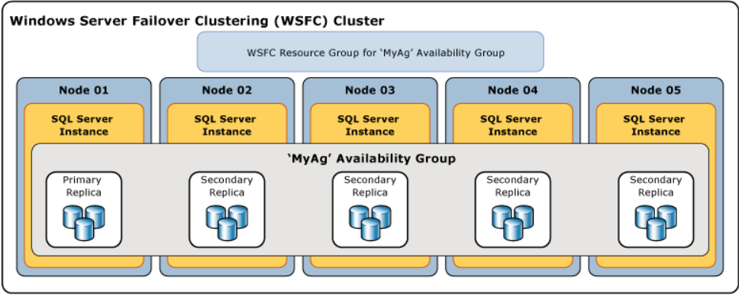
Modern SQL Server Features That Make Life Better
HA/DR Category
Availability Groups (2012 and Up, but don’t try it on 2012)
https://bit.ly/3xieeks (MS Docs - What is an AlwaysOn Availability Group)
https://bit.ly/3dqxjrG (Lee Markum - My Availability Group Database Isn’t Synchronizing)
https://bit.ly/3xieeks MS Docs depiction
Notes:
The first feature in the HA/DR category we will talk about is AlwaysOn Availability Groups.
If you’re not familiar with Availability Groups, you can get more information at the MS Docs link listed on the slide. That link will cover the general topic of what an availability group is. Also, I have a blog post that will provide you with some help to deal with common troubleshooting scenarios, and that blog post is called, “My Availability Group Isn’t Synchronizing.”
The AlwaysOn Availability Groups feature is built on Windows Failover Clustering. A Windows cluster is a logical grouping of Windows machines that work together to support one or more applications.
In the depiction on the slide, multiple Windows servers are in the same Windows cluster and each SQL Server has its own storage. For Availability Groups, there is an Availability Group name that represents a collection of databases that all failover together. In this case the Availability Group name is simply “MyAG”.
It is recommended to have what is called an AG Listener set up. This is not depicted in the slide, because, surprisingly, it is difficult to find a slide with all the components. This Listener is essentially a “named connection” that your applications point to, just like the Virtual Network Name of a SQL Server Failover Cluster instance. Rather than your applications needing to know or be switched back and forth between the different SQL Server instance names on the various nodes, your application just needs to know the Availability Group Listener and it will always be connected to the correct SQL Server.
SQL Server can automatically failover the entire group of databases from the current primary to one of the secondary nodes in the event of a server restart or unexpected issue that causes an outage. This is helpful when applications depend on more than one database for proper functionality and the automatic failover provides an advantage over something like Log Shipping or Mirroring, which do not have the capability of automatic failover for a group of databases. In this way, Availability Groups make life better.
Also, unlike a SQL Server Failover Cluster, which requires shared storage and by default leaves you with a single point of failure, Availability Groups allow for data movement between the participating nodes to each nodes’ own storage. Because of this, you get redundant copies of the data.
Now, if you’re using something like a SAN for storage, you still have to coordinate with your storage person so she can ensure that SAN storage is redundant or you can have one or more computers in a remote location on a different SAN, like for Disaster Recovery.
So, in the picture, the Availability Group technology moves data from the Primary replica on the left to the secondary replicas automatically. This leads to another thing about this feature that makes life better. Disaster Recovery to a remote location is easy to do, and I’ll show you that next.

Slide 65
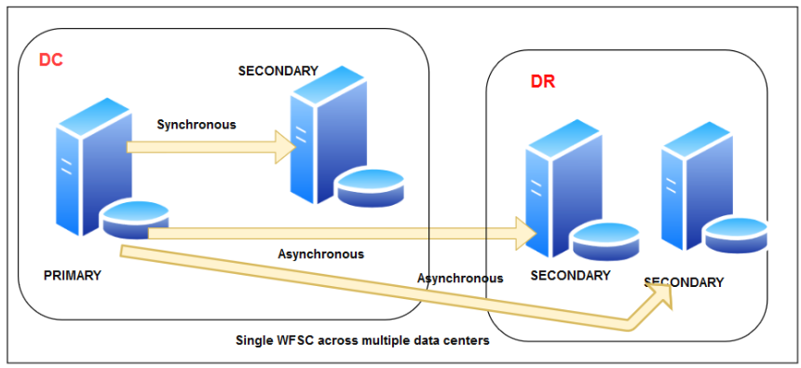
High Availability/Disaster Recovery
Primary Data Center
Disaster Recovery Location
Multi-subnet Availability Group Depiction from SQLShack: https://www.sqlshack.com/sql-server-always-on-listeners/
Notes:
Disaster Recovery to a remote location is relatively easy to do with AlwaysOn Availability Groups. No need to set up Log Shipping for a bunch of databases, and no need to set up transactional replication, if your table design will even support that. Remember, for transactional replication to work, any table you want to use it with must have a primary key. From experience, I know that a lot of databases out there don’t have primary keys for all their tables.
A common way to set up DR using Availability Groups is what is called a multi-subnet failover cluster. In this scenario, you would add one or more nodes in a remote location to the existing Windows Failover Cluster. These nodes would be on a different part of the network than the initial cluster.
You will set up your AG Listener with a remote IP address that matches the IP range of your remote nodes. If the application that will be connecting to the AlwaysOn Availability Group does not support Multi-subnet Failover, then it is best practice to change the setting called “RegisterAllProvidersIp” to a value of zero so that it is off. Changing this to zero prevents your client connections from trying to reach the primary data center and disaster recovery IP addresses in a sequential manner. Any client trying the IP address of the inactive Listener in your DR site will timeout because the Listener IP address there is not online. With this setting off, the client will only see the IP address of the active Listener. In contrast, if the application does support multi-subnetfailover = true, then leave registerallproviderips set to 1. This will allow the application to try both IP addresses at the same time and make a more immediate connection to whichever IP is online.
There is another kind of AG called a Distributed Availability Group, but it is the more complex way to set up disaster recovery with Availability Groups and I won’t be covering that option.
One last thing about this feature of SQL Server that makes life better is the built-in ability to make the databases in the AG readable. This makes them available as a source for querying for near real time reporting from your secondary nodes, relieving your primary server of the workload associated with reporting. You can take this a step further and set up what is called Read Only Routing, which will allow all connections to still use the AG Listener, but based on a connection string change for those connections, SQL Server will know to re-direct those queries to a readable secondary.
Making another computer available for SELECT queries can be done in Log Shipping, but with some complications related to disconnecting users to restore more transaction logs. A readable secondary can be done with Mirroring, but that involves using a static database snapshot of the mirrored database on the secondary. Database snapshots can introduce complications in other areas. Availability Groups, however, easily give you readable secondaries that allow users to report on data in real time.

Slide 66
High Availability/Disaster Recovery
Things You Need to Make AGs Successful
The proper team members
Multiple people who understanding Windows Clustering well
Multiple DBAs who understand the AG components well
Multiple network SMEs
Knowledge of cloud provider requirements for AGs in IaaS
Notes:
I’ve talked about a number of things for Availability Groups and so here is a summary of some things I believe are positives for Availability Groups. I feel like these features make your life better as a data professional

Slide 67
High Availability/Disaster Recovery
Multi-subnet in AWS IaaS
https://bit.ly/3YwYSZi AWS Documentation
Requires the AG to be multi-subnet.
Strongly suggested to use multiple Availability Zones.
EVERY ec2 instance in the AG has to be in its own subnet.
Storage can be ebs or FSx Netapp for ONTAP.
A story about upgrading SQL Server AGs in AWs IaaS
Notes:
I’ve talked about a number of things for Availability Groups and so here is a summary of some things I believe are positives for Availability Groups. I feel like these features make your life better as a data professional

Slide 68
High Availability/Disaster Recovery
Accelerated Database Recovery(2019)
https://www.mssqltips.com/sqlservertip/5971/accelerated-database-recovery-in-sql-server-2019/
Uses the “persisted version store” in the user DB to do a logical revert
Processes the TLOG from the last checkpoint
Off by default in on-prem SQL Server
On by default in SQL Database and Managed Instance and can’t be disabled
Multi-threaded version cleanup available in 2022 up to the # of cores with the ADR Cleaner Thread Count option in sp_configure
Notes:
The next HA/DR feature under discussion is Accelerated Database Recovery. The feature uses the “persisted version store” in each database to enable SQL Server to rollback faster via logical revert. The persisted version store works in a similar fashion to Read Committed Snapshot Isolation. It keeps the previous version of a row so that if a transaction is aborted SQL Server can simply replace the uncommitted row change with the previous version of the row.
This is quicker and different than logically replaying the records in the log to undo the change. There is also a mechanism that sweeps the database every 60 seconds to eliminate row versions that are no longer needed.
For example, let’s say that your company wants to change the email format it is storing for people to a FirstName.LastName@domain.com format. Let’s suppose that while updating email addresses for your company, someone realizes that the script is taking far longer than expected, and they suspect a problem with the script that was ran.
You might be trying to decide if you should abort and let SQL Server rollback all the changes. Someone then suggests restarting SQL Server because they know it runs crash recovery on start up and they think that will be faster. You restart and 10 minutes later, you’re still waiting for this database to come online because it’s rolling back all the changes from the log via the traditional rollback and recovery method.
With ADR your life is better because SQL Server comes back much, much faster in that scenario. ADR simply reverts the changed rows to their previous states based on row versions kept in the database. No need to work through the log undoing or rolling back uncommitted changes. Instead, the Transaction Log is only processed from the last successful checkpoint.
I’ve personally seen this change cause crash recovery that was taking 45 minutes take a matter of seconds instead.

Slide 69
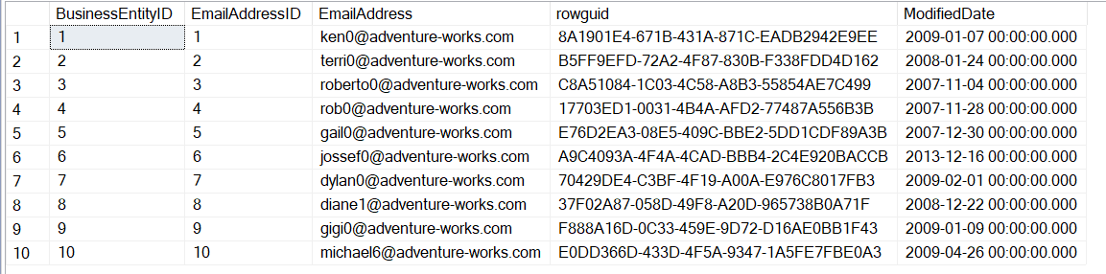
High Availability/Disaster Recovery
Accelerated Database Recovery(2019)
Notes:
The next HA/DR feature under discussion is Accelerated Database Recovery. The feature uses the “persisted version store” in each database to enable SQL Server to rollback faster via logical revert. The persisted version store works in a similar fashion to Read Committed Snapshot Isolation. It keeps the previous version of a row so that if a transaction is aborted SQL Server can simply replace the uncommitted row change with the previous version of the row.
This is quicker and different than logically replaying the records in the log to undo the change. There is also a mechanism that sweeps the database every 60 seconds to eliminate row versions that are no longer needed.
For example, let’s say that your company wants to change the email format it is storing for people to a FirstName.LastName@domain.com format. Let’s suppose that while updating email addresses for your company, someone realizes that the script is taking far longer than expected, and they suspect a problem with the script that was ran.
You might be trying to decide if you should abort and let SQL Server rollback all the changes. Someone then suggests restarting SQL Server because they know it runs crash recovery on start up and they think that will be faster. You restart and 10 minutes later, you’re still waiting for this database to come online because it’s rolling back all the changes from the log via the traditional rollback and recovery method.
With ADR your life is better because SQL Server comes back much, much faster in that scenario. ADR simply reverts the changed rows to their previous states based on row versions kept in the database. No need to work through the log undoing or rolling back uncommitted changes. Instead, the Transaction Log is only processed from the last successful checkpoint.
I’ve personally seen this change cause crash recovery that was taking 45 minutes take a matter of seconds instead.

Slide 70
Accelerated Database Recovery
Enhancement in SQL Server 2022
New sp_configure options:
ADR Cleaner Thread Count – Multi-threaded version cleanup available in 2022 up to the # of cores
ADR cleaner retry timeout(min) – Changes the default from 120 in SQL Server 2019 to 15 in 2022. Cleans up persisted version stores no longer needed.
Notes:
ADR Cleaner Thread Count setting allows for ADR to use more than one thread. In 2019, there’s only one thread available so ADR can only be performed on one database at a time. You can set the ADR thread count in 2022 to match the number of cores on the SQL Server. So, if you have 16 cores, you can set this to 16 and ADR can be performed on up to 16 databases in parallel.
ADR cleaner retry timeout - The cleaner is the asynchronous process that wakes up periodically and cleans page versions that aren't needed. ADR cleaner retry timeout (min) controls the amount of time the cleaner would spend exclusively retrying object lock acquisition and cleanup of page before abandoning the sweep. Completion of a sweep with 100 percent success is essential to keep the growth of aborted transactions in the aborted transactions map. If the separate list can't be cleaned up in the prescribed timeout, then the current sweep will be abandoned and the next sweep will start.
--https://cloudblogs.microsoft.com/sqlserver/2023/03/28/accelerated-database-recovery-enhancements-in-sql-server-2022/

Slide 71
Modern SQL Server Features That Make Life Better
How can you discover information about new SQL Server features?
https://docs.microsoft.com/en-us/sql/sql-server/what-s-new-in-sql-server-2016?view=sql-server-ver15 (The page has links in the left window of the site to 2016-2019)
https://docs.microsoft.com/en-us/previous-versions/sql/ (You guessed it, everything prior to SQL 2016)
Various MSSQLTIPS articles: https://www.mssqltips.com/sqlservertip/4574/new-features-in-sql-server-2016-service-pack-1
https://www.mssqltips.com/sqlservertip/5376/tsql-enhancements-in-sql-server-2017/
https://blog.pythian.com/top-10-new-features-of-sql-server-2019/
https://www.sentryone.com/blog/aaronbertrand/fishing-for-features-in-ctps
https://www.sentryone.com/blog/aaronbertrand/more-changes-sql-server

Slide 72
Modern SQL Server Features That Make Life Better
Bonus Material
SSISDB catalog (SQL 2012)
In-Memory OLTP(SQL 2014) – This can produce significant improvements for some workloads.
Backup encryption (2014)
Always Encrypted (2016)
Dynamic Data Masking(2016)
Row Level Security(2016)
ColumnStore Indexes (2012, but many enhancements since)
Data Virtualization/External tables (2019)
Forced Plan Optimization (2022)
CE_Feedback (2022)
Tempdb metadata optimization (2022)
Notes:
There have been some enhancements to In-Memory OLTP since it’s release, but I think there are still a fair number of things that restrict the use case for this feature.
For people who like scripting languages, the ability of SQL Server to incorporate the execution of Python and R scripts could be useful, particularly in the areas of Machine Learning, which is used for, among other things, predictive analysis. It can sift through data and find trends and extrapolate based on the data in the sample data model. Python and R in SQL Server can also be used for Business Intelligence.
Always Encrypted encrypts data in transit as it passes between SQL Server and database client applications.

Slide 73
Modern SQL Server Features That Make Life Better
Summary
Discussed features in the following categories:
Performance
Intelligent Query Processing, Query Store
Troubleshooting
Verbose truncation warnings, temporal tables
Permissions
CONNECT ANY DATABASE, SELECT ALL SECURABLES, new Server level roles in 2022
High Availability/Disaster Recovery
Availability Groups, Accelerated Database Recovery

Slide 74
Modern SQL Server Features That Make Life Better
Summary
Discussed features in the following categories:
Performance
Intelligent Query Processing, Query Store
Troubleshooting
Verbose truncation warnings, temporal tables
T-SQL
OFFSET FETCH, THROW, new date and datetime related functions
High Availability/Disaster Recovery
Availability Groups, Accelerated Database Recovery

Slide 75
Modern SQL Server Features That Make Life Better
Thank you for attending!

Slide 76

Modern SQL Server Features That Make Life Better
QUESTIONS?

Slide 77
Contact Information
Twitter(X): @leemarkum
LinkedIn: https://www.linkedin.com/in/leemarkum/
Email: lmarkum@live.com

